Slide 1
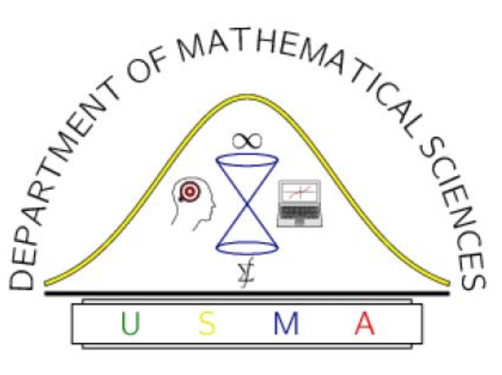
Introduction to Machine Learning
Aerial Recon of
USMA D/MATH
CPT Steve Morse
December 6, 2018

Slide 2
Agenda
Background Why machine learning? Why Python? And um … isn’t this just statistics?
The 10,000 ft view Building the black box, some terminology, a typical pipeline
Fly-over of some models:
Supervised Least squares is cool again, logistic regression, boosting/bagging, support vector machines
Deep Learning (Deep) neural networks of the plain, convolutional, and recurrent variety
Unsupervised Dimension reduction, clustering
Other topics First order methods, RKHS’s, oh hello Bayes I didn’t see you there
Closing thoughts What do the haters say, what’s next, and how do I start?

Slide 3
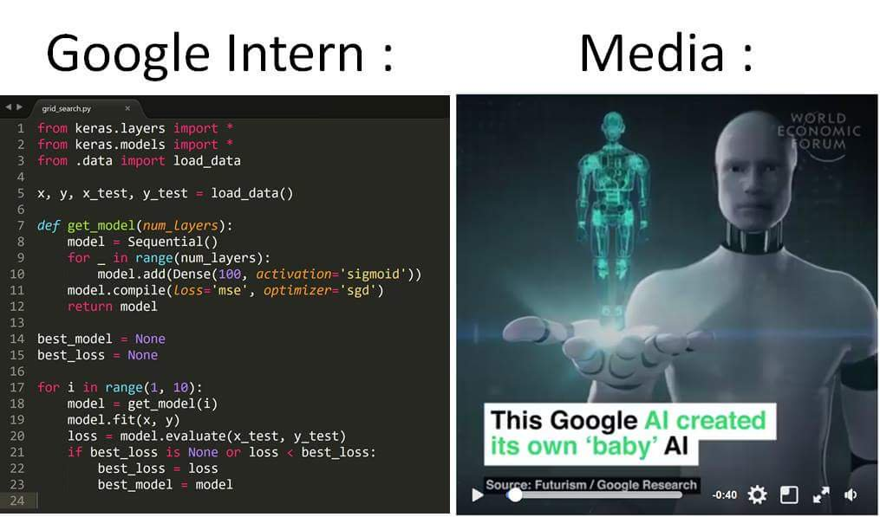
Why machine learning?
It’s famous (nb: mostly versions of deep neural nets)
World champs at chess, Go, Doom, … still working on Warcraft …
Computer vision: StreetView, self-driving cars (Tesla, Uber)
Voice, image recognition (FB’s DeepFace 97.4% accurate)
Translation (Microsoft, Google Translate approach human acc.)
Expert systems: healthcare, finance
Operations Research wants to keep a foothold in “Analytics”
Most importantly, it’s fun / exciting / cool / mathy / code-y
Hey! That’s my stuff!
Machine learning! AI!
The public
Data scientist
Operations
Researcher

Slide 4
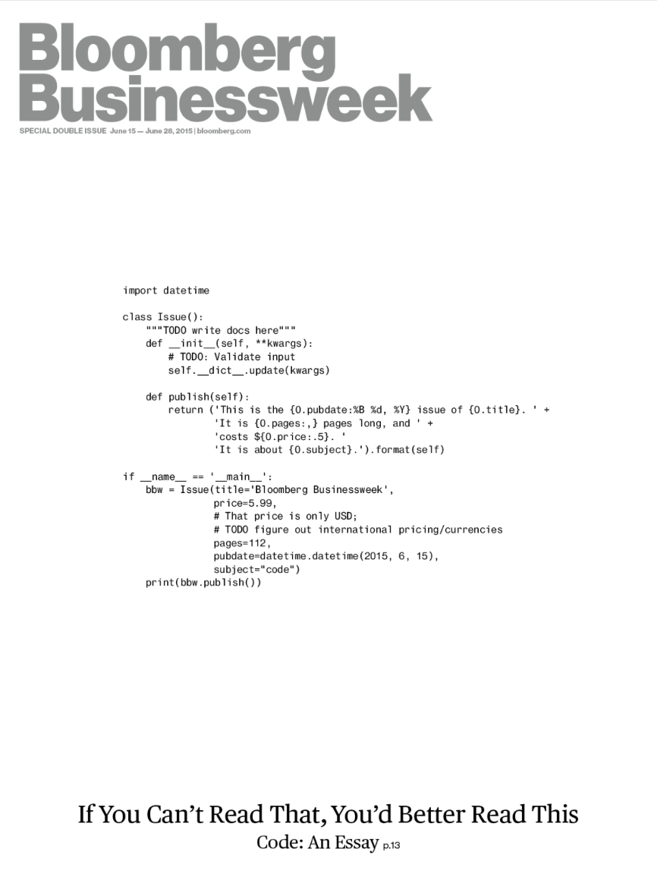
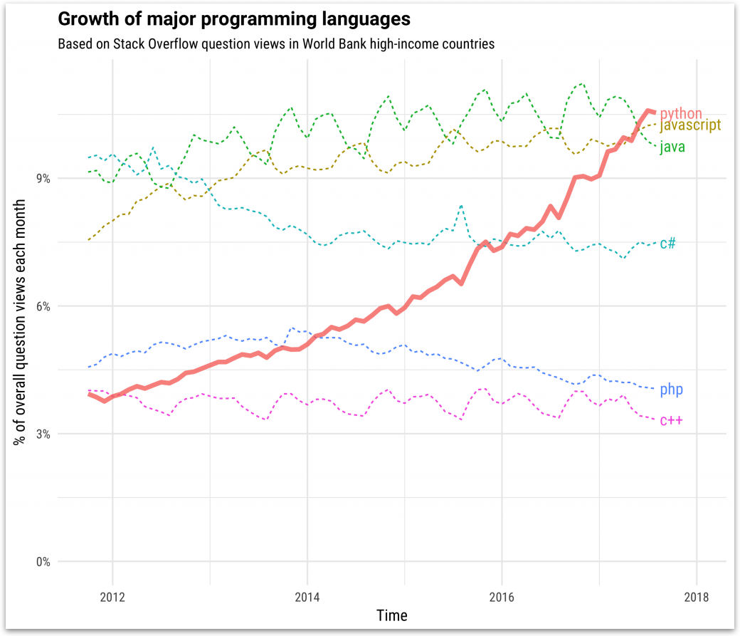
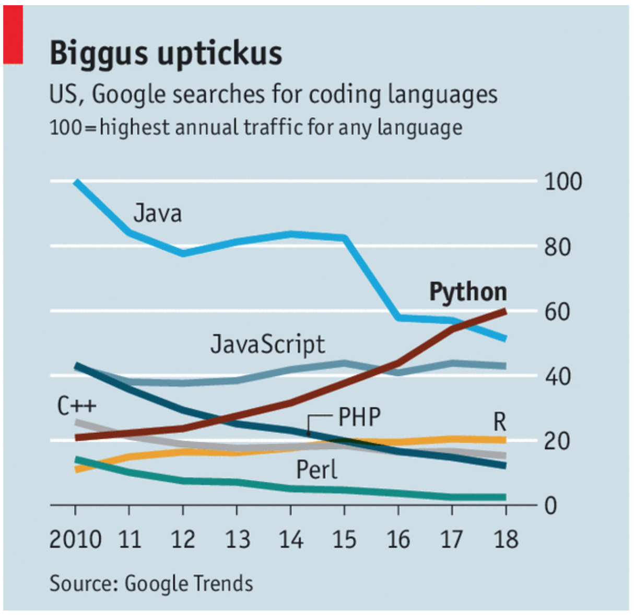
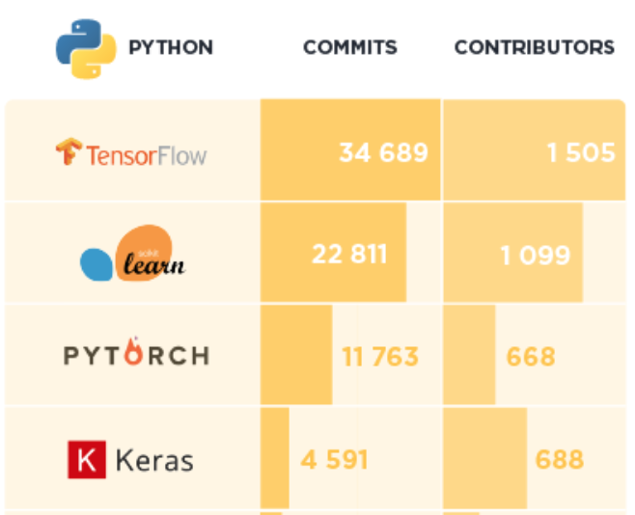
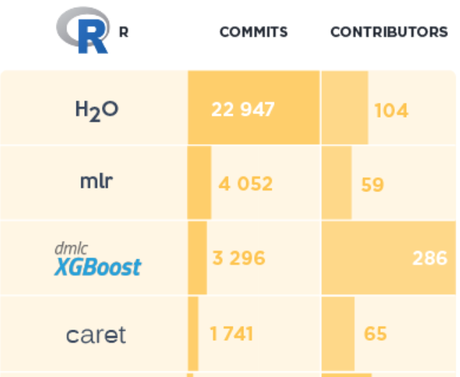
Why Python?
Alternate title: “I just learned R. Now why should I learn Python?”
Reason #1: Python is the most popular programming language in the world
Reason #2: sklearn is biggest all-in-one open-source ML library
Yeah, but … ggplot2 is still the king of visualization ¯\_(ツ)_/¯
Python contenders: matplotlib, Seaborn, pandas, ggpy, plotnine, Altair
“All happy Python programmers are the same. Each unhappy Python programmer has his/her own plotting library.” – Anna Karenina, Leo Tolstoy
Rays of hope: (1) R has very good ML libraries if you prefer it, (2) sklearn is beautifully easy even for non-native speakers, and (3) using pandas feels like R
Python
code!
“What is Code” Bloomberg cover, June 2015
Python top viewed on Stack Overflow,
Jun 2018
“Python has brought computer programming to a vast new audience” Economist, Jul 2018
caret
rpart
randomForest
e1071
mclust
…
sklearn
As of June 2018, source: activewizards.com

Slide 5

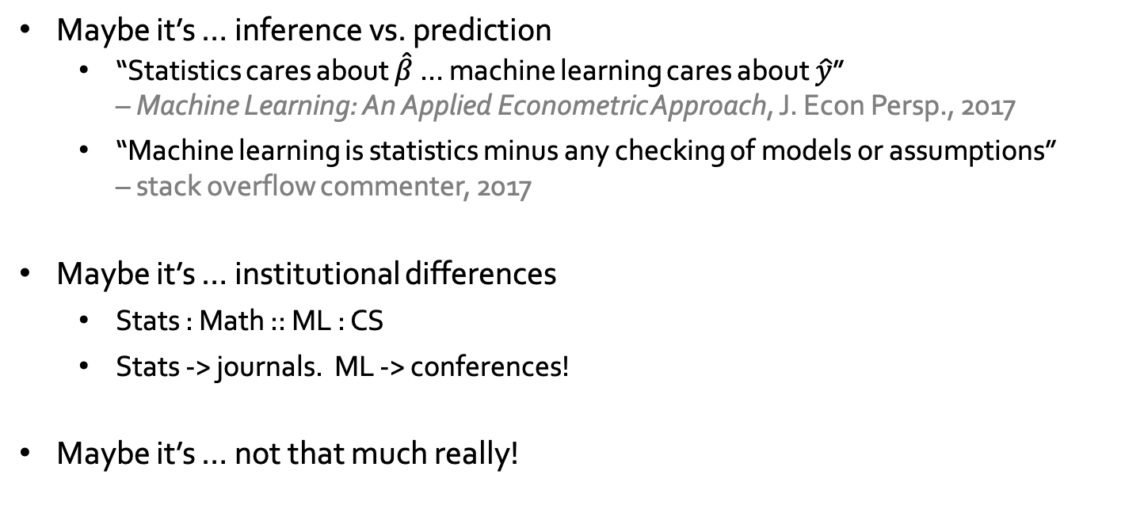
Statistics, machine learning … what’s the diff?
Maybe it’s … inference vs. prediction
“Statistics cares about $\hat{β}$ … machine learning cares about $\hat{y}$” – Machine Learning: An Applied Econometric Approach, J. Econ Persp., 2017
“Machine learning is statistics minus any checking of models or assumptions” – stack overflow commenter, 2017
Maybe it’s … institutional differences
Stats : Math :: ML : CS
Stats -> journals. ML -> conferences!
Maybe it’s … not that much really!
Statistics | Machine Learning!
Fitting | Learning
Test set performance | Generalization
Regression/classification | Supervised learning
Large grant = $50,000 | Large grant = $1,000,000
Nice place for a meeting: Las Vegas in August | Nice place for a meeting: Snowbird, Utah, French Alps
Works cited: Robert Tibshirani

Slide 6
The 10,000 ft view
DOG
CAT
Wouldn’t it be nice to know this function?

Slide 7
The 10,000 ft view
DOG
Parameters
CAT

Slide 8
The 10,000 ft view
Hyperparameters
DOG
Parameters
CAT

Slide 9
The 10,000 ft view
Feature
engineering
Hyperparameters
DOG
Parameters
CAT
Loss /
Empirical risk /
Negative log-likelihood
Penalty on complicated model
(“regularization”)
Notes:
\text{min} \ \ \sum_i L\Big(y^{(i)}, f(\phi(\mathbf{x}^{(i)}); \beta, \alpha)\Big) + \lambda ||\mathbf{\beta}||_p

Slide 10
The 10,000 ft view
Feature
engineering
Hyperparameters
DOG
Parameters
?
?
CAT

Slide 11
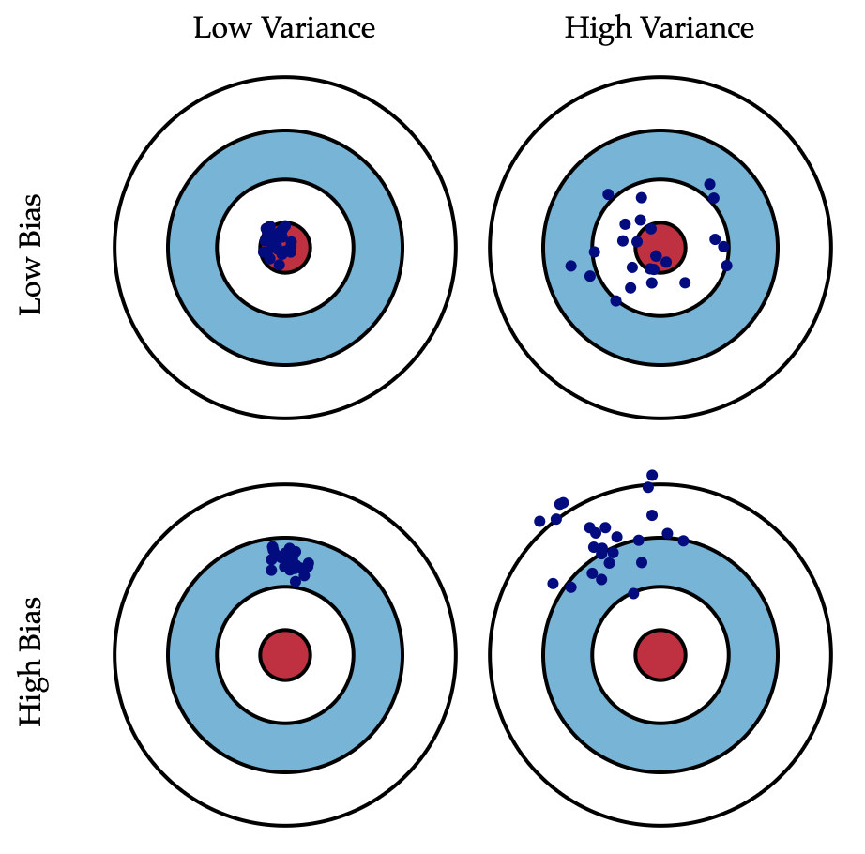
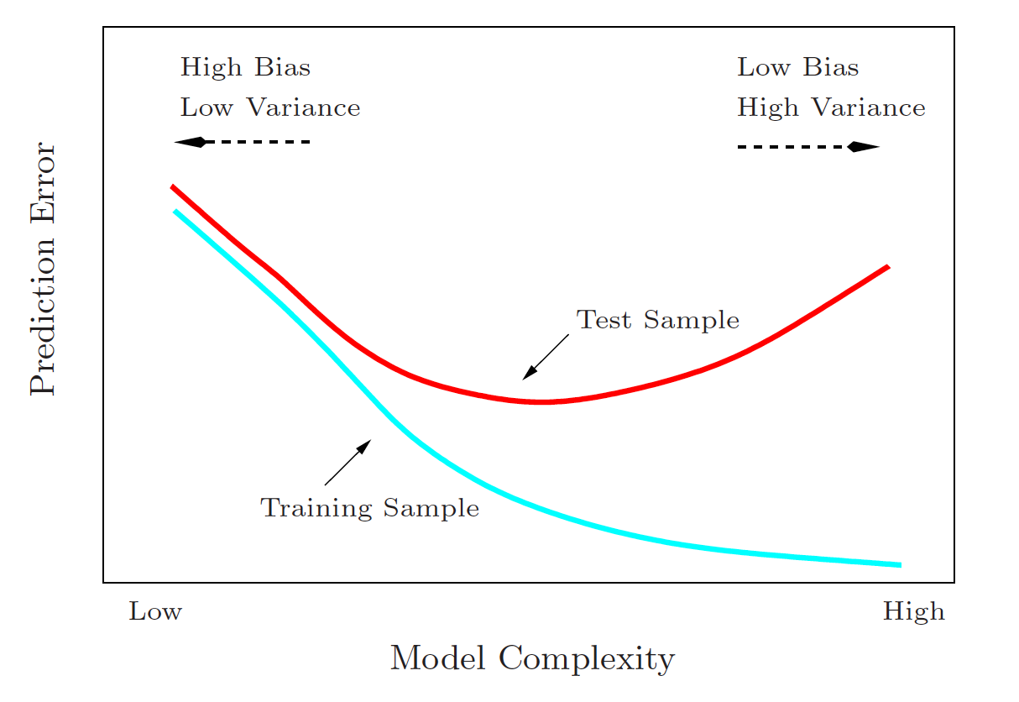
An assortment of terminology and themes
Supervised learning
Labeled data
Regression ( ) vs. classification ( )
Examples: Generalized linear models, support vector machines (SVMs), boosted methods, bagging (Random Forests), neural networks, …
Unsupervised learning
Unlabeled data
Clustering: k-means, hierarchical, spectral, …
Density estimation: GPs, DPs, …
Dimensionality reduction: PCA, SOM, topic models, …
Prediction rule vs. probabilistic (MLE / Bayesian)
Model selection
Feature engineering
Cross-validation
Bias-variance trade-off
Decision Trees
Probabilistic
Graphical models
Logistic Regression
Logistic Regression
Linear Regression
Interpretable
SVMs
Bagging
SVMs
Boosting
AdaBoost
Random Forest
Neural nets
Flexible
Non-probabilistic
Bias / variance
tradeoff
Bias
Variance
Works cited: ESL, Bishop

Slide 12
A machine learning pipeline
Exploratory Data Analysis
Histograms
Scatterplots
Pattern finding
Feature Engineering
By-hand or automated
Transformations / kernels
Typically requires domain knowledge
Related terms: feature selection, feature learning
Model selection
Training data
Cross-validation selects model which does well out-of-sample in expectation
Feature
Engineering
Training
Validation
Out-of-sample
testing
Data
EDA
Train
Test
k-fold c.v.

Slide 13
Case Study: Making least squares cool again
Old school + slap some regularization on there!
Maximum likelihood estimation (MLE)
Let’s get (a little bit) Bayesian
SSE
Penalty on big w
(“regularization”)
LASSO
Ridge
Elastic Net
Assume a linear model with Gaussian error
Implies y is normally dist., given an x
math!
Themes:
Minimizing error/NLL + penalty
Regularization
Re-framing prediction-rule paradigms (e.g. squared error) in probabilistic terms (e.g. MLE)
Likelihood
(“how likely is it these parameters created this data?”)
Identical to least squares!*
Uniform prior = OLS
Gaussian prior = Ridge
* Gauss invented Least Squares. Gauss invented the normal distribution. Coincidence???
Least squares again … with regularization!
Notes:
\text{arg}\min_{w_0, \mathbf{w}} \sum_{i=1}^N (y_i - w_0 - \mathbf{w}^T x_i)^2 + \lambda ||\mathbf{w}||_q
Y|X \sim \mathcal{N}(\mathbf{w}^T \mathbf{x}, \sigma^2)
\mathcal{L}(\mathcal{D}|\mathbf{w}) = \prod_{i=1}^N \text{Pr}(y_i | \mathbf{x}_i, \mathbf{w})
\text{arg}\min_{\mathbf{w}} -\log \mathcal{L}(\mathbf{w})
||\cdot||_1 \ ||\cdot||_2 \ ||\cdot||_1 + ||\cdot||_2
\mathbf{w}_{\text{MAP}} \overset{\text{def}}{=} \text{arg}\max \ \text{Pr}(\mathbf{w}|\mathcal{D})
&= \text{arg}\max \ \frac{\text{Pr}(\mathcal{D}|\mathbf{w}) \text{Pr}(\mathbf{w})}{\text{Pr}(\mathcal{D})} \\
&= \text{arg}\max \ \text{Pr}(\mathcal{D}|\mathbf{w}) \text{Pr}(\mathbf{w}) \\
&= \text{arg}\max \ \log \mathcal{L}(\mathbf{w}) + \log \text{Pr}(\mathbf{w})

Slide 14
Support Vector Machines (SVM)
Idea: place a separating hyperplane that maximizes separation between different classes
History: origins in 1963, but the ”kernel trick” and “soft-margin” versions launched it into popularity in mid-90’s.
Math:
The “kernel trick”
Pros: powerful, flexible classifier that works even with small/medium amounts of data
Cons: requires more feature engineering (preprocessing, selection of kernel) than methods like boosting or NNs
support vectors
Penalty on big w
(“regularization”)
Hinge loss
Kernel transformation:
Works cited: kdnuggets, Wikipedia
Notes:
\text{min} \ \ &||\mathbf{w}||^2 + C\sum_i \zeta_i \\
\text{s.t.} \ \ &y^{(i)}(\mathbf{w}^T \mathbf{x}^{(i)}+b)\geq 1 - \zeta_i \\
&\zeta_i \geq 0

Slide 15
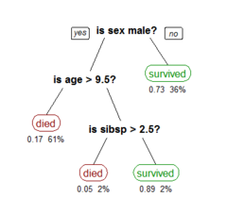
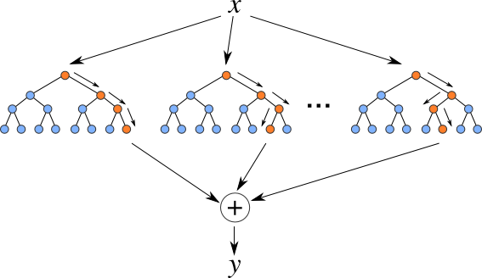
Boosting, Bagging, and Beating Navy
Idea: lots of ”weak learners” make a strong learner
Decision Trees
Greedily select weak learners (“decision stumps!”)
Grow a large tree, then prune
Pros: interpretable, fast, handles nonlinearities
Cons: tends to overfit, not robust, usually a weak predictor
(Gradient) Boosting – example: AdaBoost
Fit a series of weak learners (possibly small DTs)
Choose each one to minimize residual
Pros: great out-of-the-box model, fast
Cons:
Bootstrap aggregation (“bagging”) – example: Random Forest
Randomly select different parts of the data (bootstrap)
Grow a decision tree on each one
Take a weighted average of the “vote” of each DT (aggregate)
Pros: powerful predictor, esp. with nonlinearities
Cons: not interpretable, slow
Decision Tree
var2
var 1
Random Forest

Slide 16
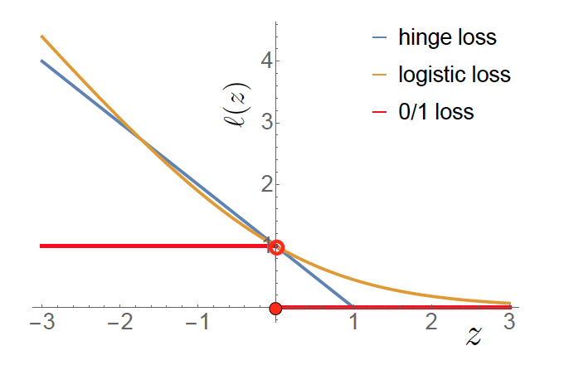
An aside: on loss functions
Notes:
\text{min} \ \ &||\mathbf{w}||^2 + C\sum_i \zeta_i \\
\text{s.t.} \ \ &y^{(i)}(\mathbf{w}^T \mathbf{x}^{(i)}+b)\geq 1 - \zeta_i \\
&\zeta_i \geq 0

Slide 17
A second aside: on kernels
Notes:
\text{min} \ \ &||\mathbf{w}||^2 + C\sum_i \zeta_i \\
\text{s.t.} \ \ &y^{(i)}(\mathbf{w}^T \mathbf{x}^{(i)}+b)\geq 1 - \zeta_i \\
&\zeta_i \geq 0

Slide 18
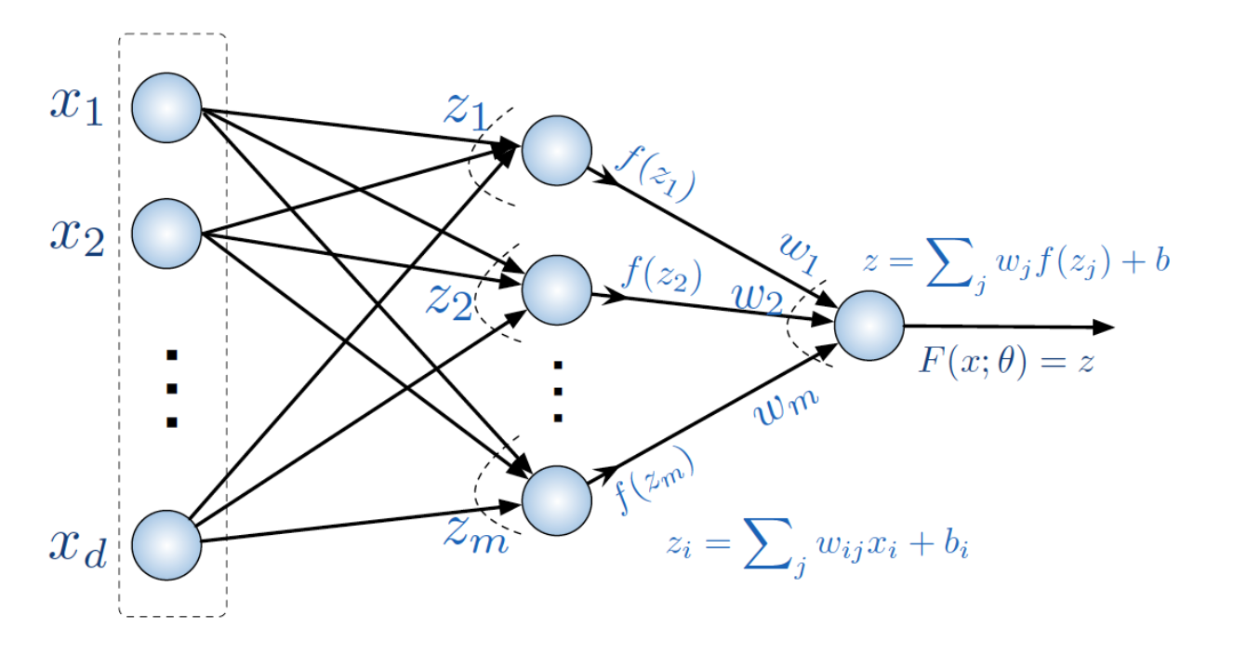
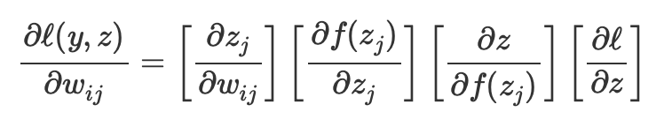
Neural nets
Idea: choosing the right parametric form is hard, so let’s have a layered, non-linear model and we can capture anything!
History:
Early: “Perceptron” (1958), back-prop (1970-80), power of multilayer (1989)
Middle: (1990’s) Variants (CNN, RNN, RL) and fixes (LSTM, dropout)
Now: (2004-present) big data + faster tech (GPUs) + various hacks = deep learning
Pros/Cons: powerful, flexible, requires little-to-no FE, but not well-suited for small datasets, not interpretable
Why do NNs work so well?
Maybe: SGD tends to find “flat” optimums, which generalize better (https://www.inference.vc/everything-that-works-works-because-its-bayesian-2/)
Math:
NN architecture:
Feed-forward, back-prop:
(linear)
aggregation
(non-linear)
activation
Input layer
(a datapoint)
Hidden layer
Output layer

Slide 19
Code break!

Slide 20
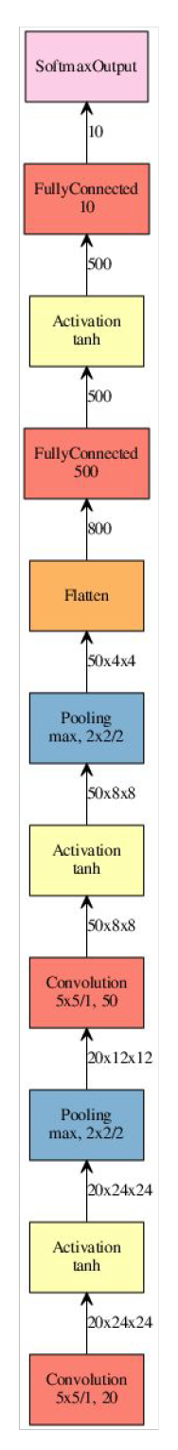
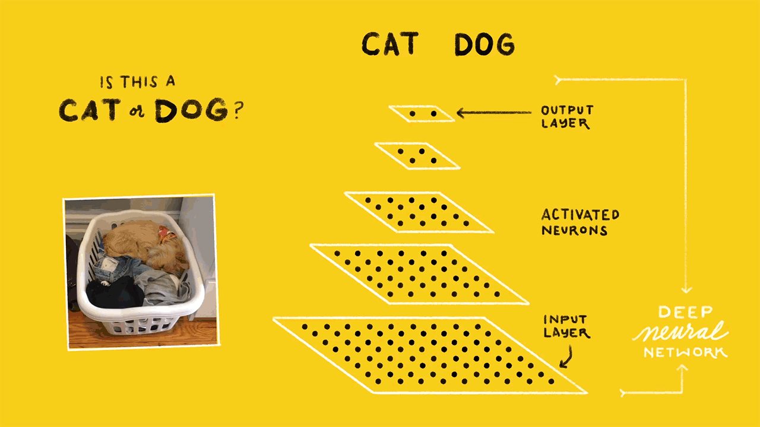
Convolutional Neural Nets (CNNs)
Idea: there is local structure within each input (for example: an image)
Math:
Convolutional layers
Weight sharing = structure
Fast matrix multiplication
Pooling layers
Max / averaging
Typical application is “computer vision” (image recognition)
LeNet
1998
AlexNet
2012
GoogLeNet
2014
Inception
2015
Works cited: medium.com/@RaghavPrabhu, josephpcohen.com

Slide 21
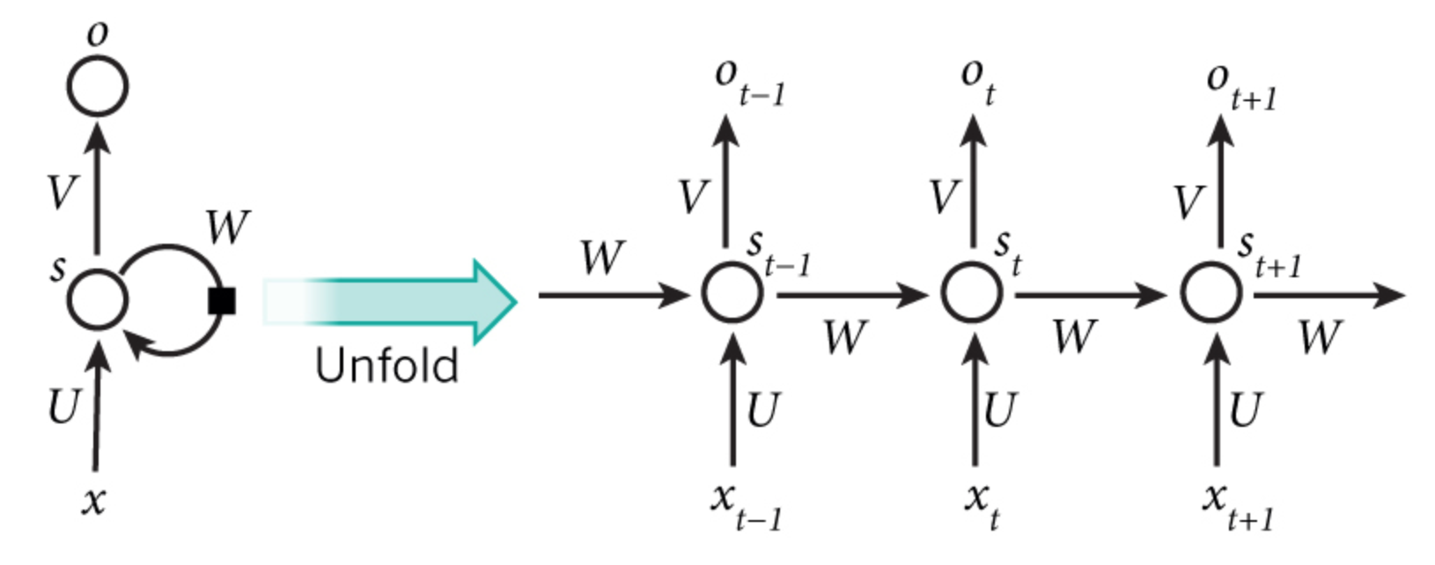
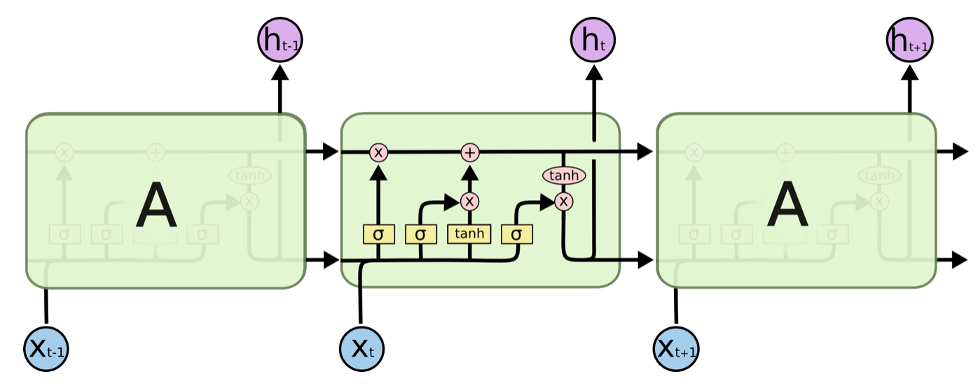
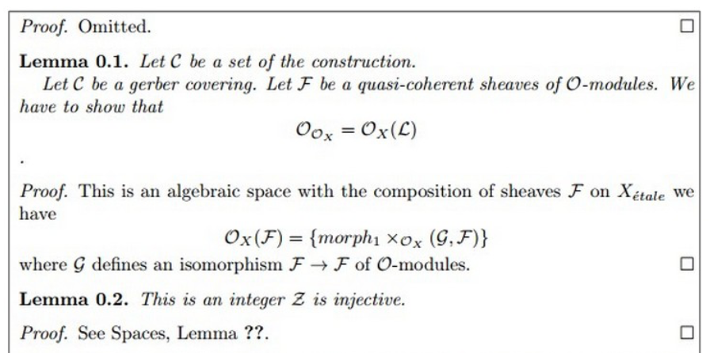
Recurrent Neural Nets (RNNs)
Idea: nearby input vectors are correlated (think time series, or language)
Math:
Hidden state (like a memory) computes activation using previous hidden state and current input
Back-prop through time (BPTT) used to train (but vanishing gradients lead to short-term memory)
Long-short-term-memory (LSTM) cells expand the long-term memory of the hidden states
Ex. “I grew up in France. I speak fluent _____.”
Typical applications: time series forecasting, sentiment analysis, machine translation, image captioning
Check out: karpathy.github.io/2015/05/21/rnn-effectiveness/
LSTM cell:
Example:
RNN given an algebraic geometry text, asked to generate new samples. This requires learning the structure of LaTeX and of things like Lemma-Proof.
😳

Slide 22
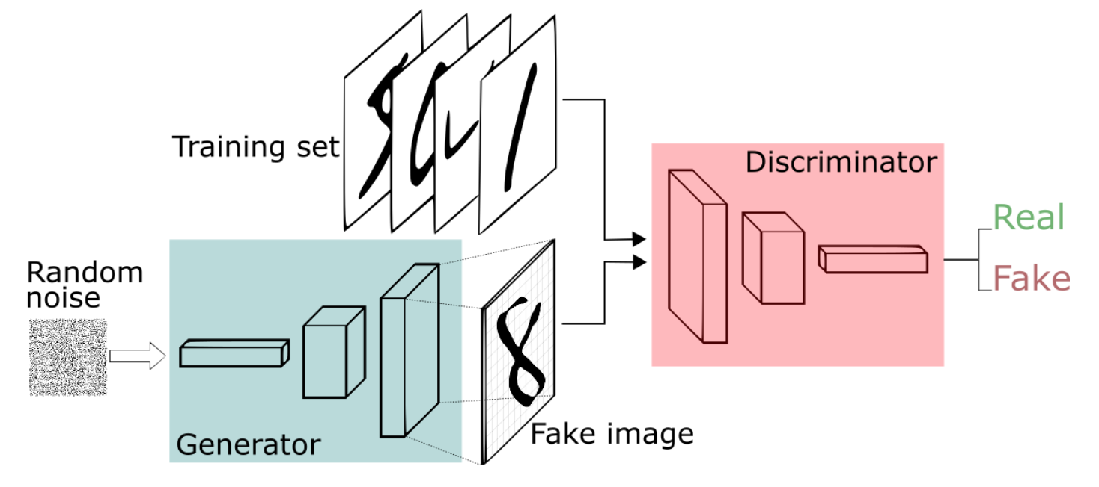
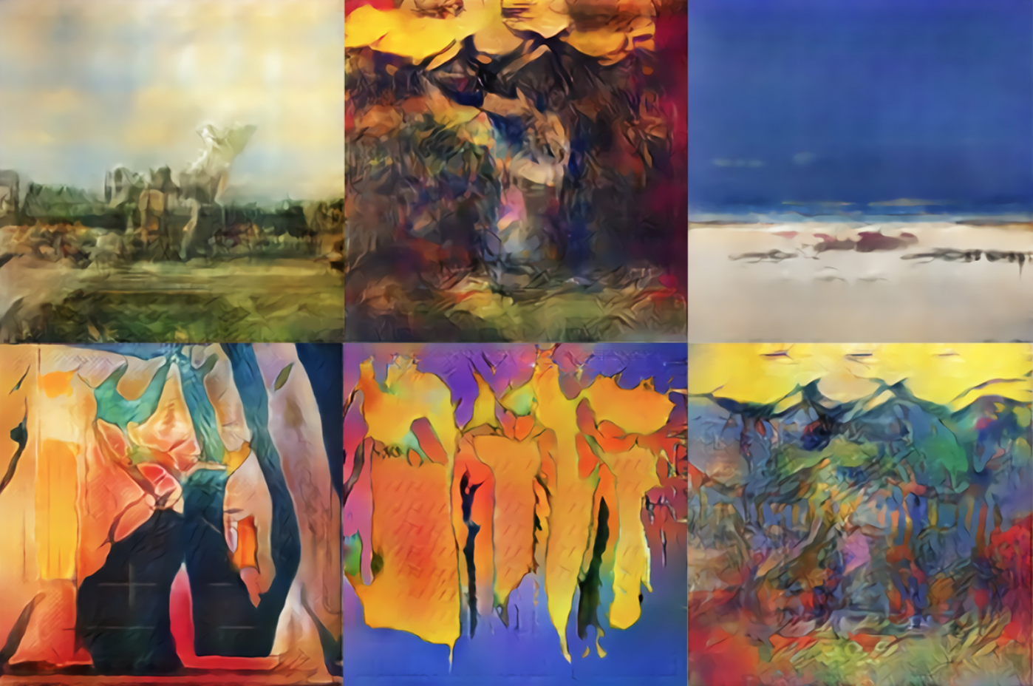
Generative Adversarial Networks (GANs)
Idea: make a neural network generate more realistic samples by having a different neural network try to classify whether the sample was fake or not
Applications:
Nice: Image enhancement, data generation, generating photorealistic images for designers, games
Naughty: Generating counterfeits: (“deep fake”)
Fake video: Pres. Trump chastising Belgian citizens https://www.theguardian.com/technology/2018/nov/12/deep-fakes-fake-news-truth
Fake images: AI generated painting sells for $432k https://www.nytimes.com/2018/10/25/arts/design/ai-art-sold-christies.html

Slide 23
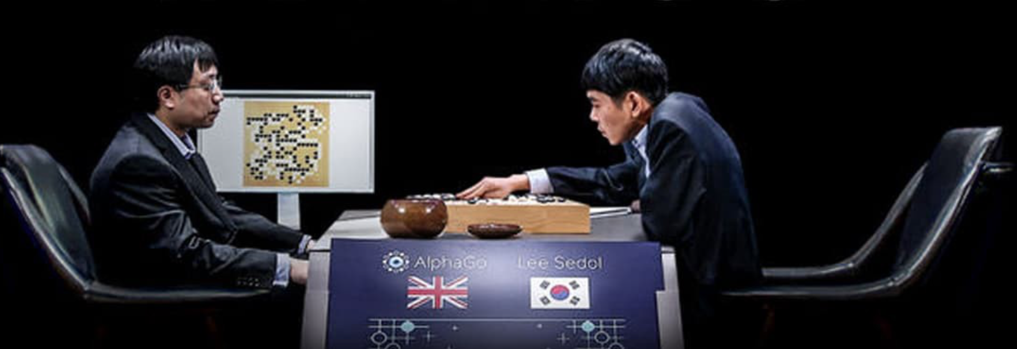
Reinforcement Learning (RL)
Idea: create a flexible model, reward it for desired behavior, and let it evolve over time
Math:
Agent observes state x₀ and selects an action y₀
It receives a “reward” r₀ which depends on x₀ and y₀
Environment transitions probabilistically to a new state x₁ with distribution depending only on x₀, y₀
Goal: find a policy mapping states to actions that maximizes rewards
A big limitation: requires an enormous amount of data, so typically limited to areas where data can be generated
Applications: robot control, gaming, network control, automated bidding, …
Google DeepMind’s AlphaGo algorithm defeats World Champion Lee Sedol in March 2016

Slide 24
Code break!

Slide 25
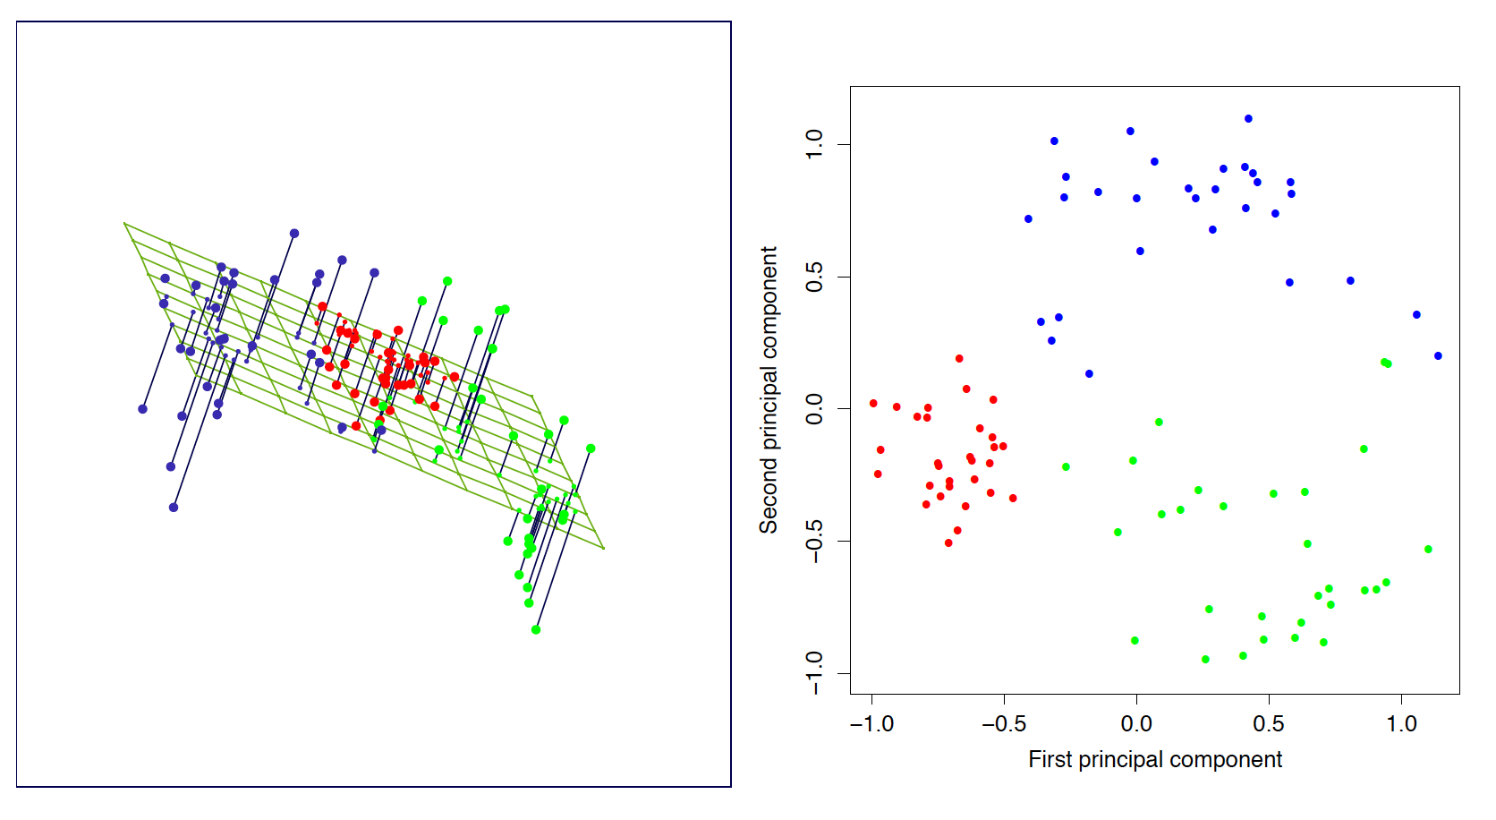
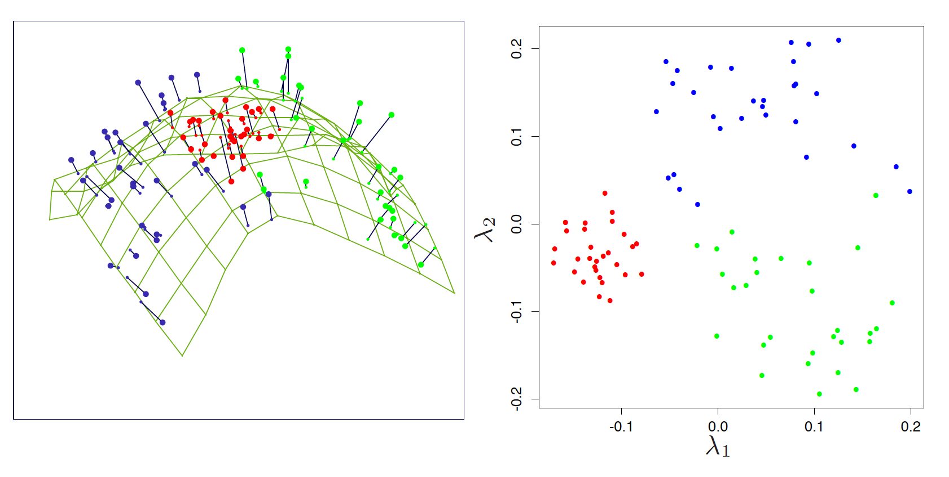
Dimensionality reduction
Idea: many high-dimensional datasets can be well-represented on a low dimensional manifold
Example: Principal Component Analysis (PCA)
”Principal components” are coordinates of data projected onto hyperplane which maximizes variance
Math:
Applications:
Factor analysis
Topic modeling
Feature engineering
Visualization
Some cool, exotic methods: UMAP, t-SNE
PCA:
Kernel PCA:
Works cited: ESL

Slide 26
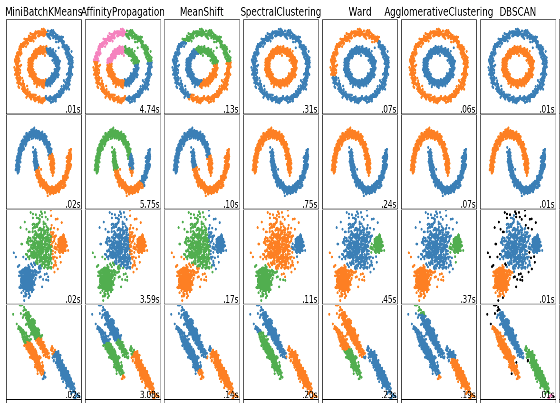
Clustering
Idea: find groupings of data so data in the same group is similar, and data in different groups is dissimilar
k-means clustering
Workhorse, fast, assumes spherical clusters
Hierarchical / agglomerative clustering
Handles any distance metric, fast but greedy, handles non-convexity, sensitive to reordering of the data
Spectral clustering
Clusters in eigenspace of the distance matrix, slow, handles non-convexity
DBSCAN
Fast, handles non-convexity, auto-selects no. of clusters, identifies outliers, tricky to tune parameters
Affinity propagation
Assigns data to same cluster if they share a basin in similarity-space, does not scale well to large datasets
Mean shift
Gaussian Mixture Models
Latent Dirichlet Allocation (LDA)
Birch
…

Slide 27
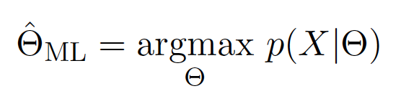
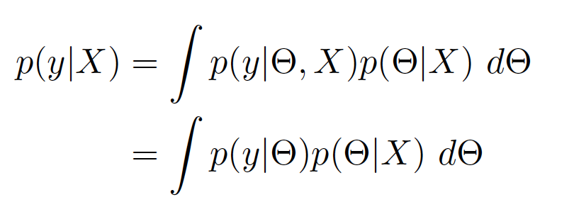
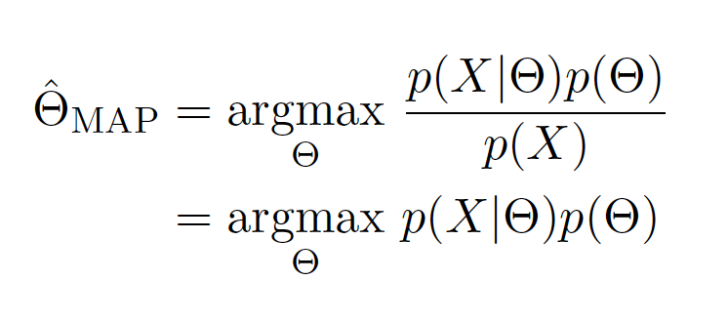
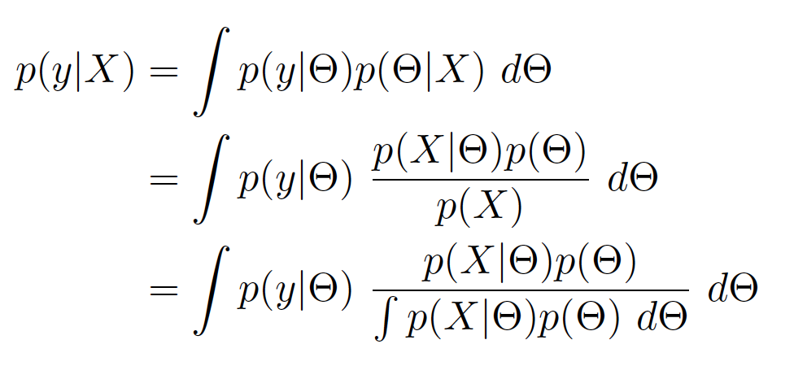
We are Borg Bayesian
Math (one view):
Nearly every method mentioned thus far has a Bayesian variant (counterpoint: every method thus far is just a degenerate case of a Bayesian approach – example: k-means vs. GMM using EM)
Approaches to attack the nasty integrals:
Variational methods: compute an approximate posterior exactly
Monte Carlo methods: compute an exact posterior approximately
Interested?? Check out “Fridays with Reverend Bayes”
don’t approximate!
Predictive Posterior
Approximation

Slide 28
I’m feeling a little bit saucy mathy
Optimization (old-school OR!)
First-order methods: long ignored for being perceived as overly simple, now the workhorse of modern ML because they’re simple and fast
Gradient descent
Variants:
Stochastic Gradient Descent
Accelerated methods (“momentum”)
Expectation-Maximization / Projected GD
Statistical Learning Theory
Reproducing Kernel Hilbert Spaces (RKHS)
Representer theorem: ”best possible” estimator has finite representation
Implication: SVM+RBF kernel, NN are universal estimators
GD:
SGD:
momentum
AGD:
EM:
(PGD)
projection
maximization
Notes:
\mathbf{w}_{k+1} = \mathbf{w}_k - h \nabla f_i(\mathbf{w}_k)
\text{min} \ \ f(\mathbf{w}) := \sum_i f_i(\mathbf{w})
\mathbf{w}_{k+1} = \mathbf{w}_k - h \nabla f(\mathbf{w}_k) + \beta (\mathbf{w}_k - \mathbf{w}_{k-1})
Q(\mathbf{w}|\mathbf{w}_{k}) &= \mathbb{E}[\mathcal{L}(\mathbf{w}; \mathbf{X}, \mathbf{Z})] \\
\mathbf{w}_{k+1} &= \text{argmax} \ Q(\mathbf{w}|\mathbf{w}_k)
f^* &= \text{argmin} \ L(\mathbf{X}, f) + g(f) \\
f^* &= \sum_i \alpha_i k(\cdot, x_i)

Slide 29
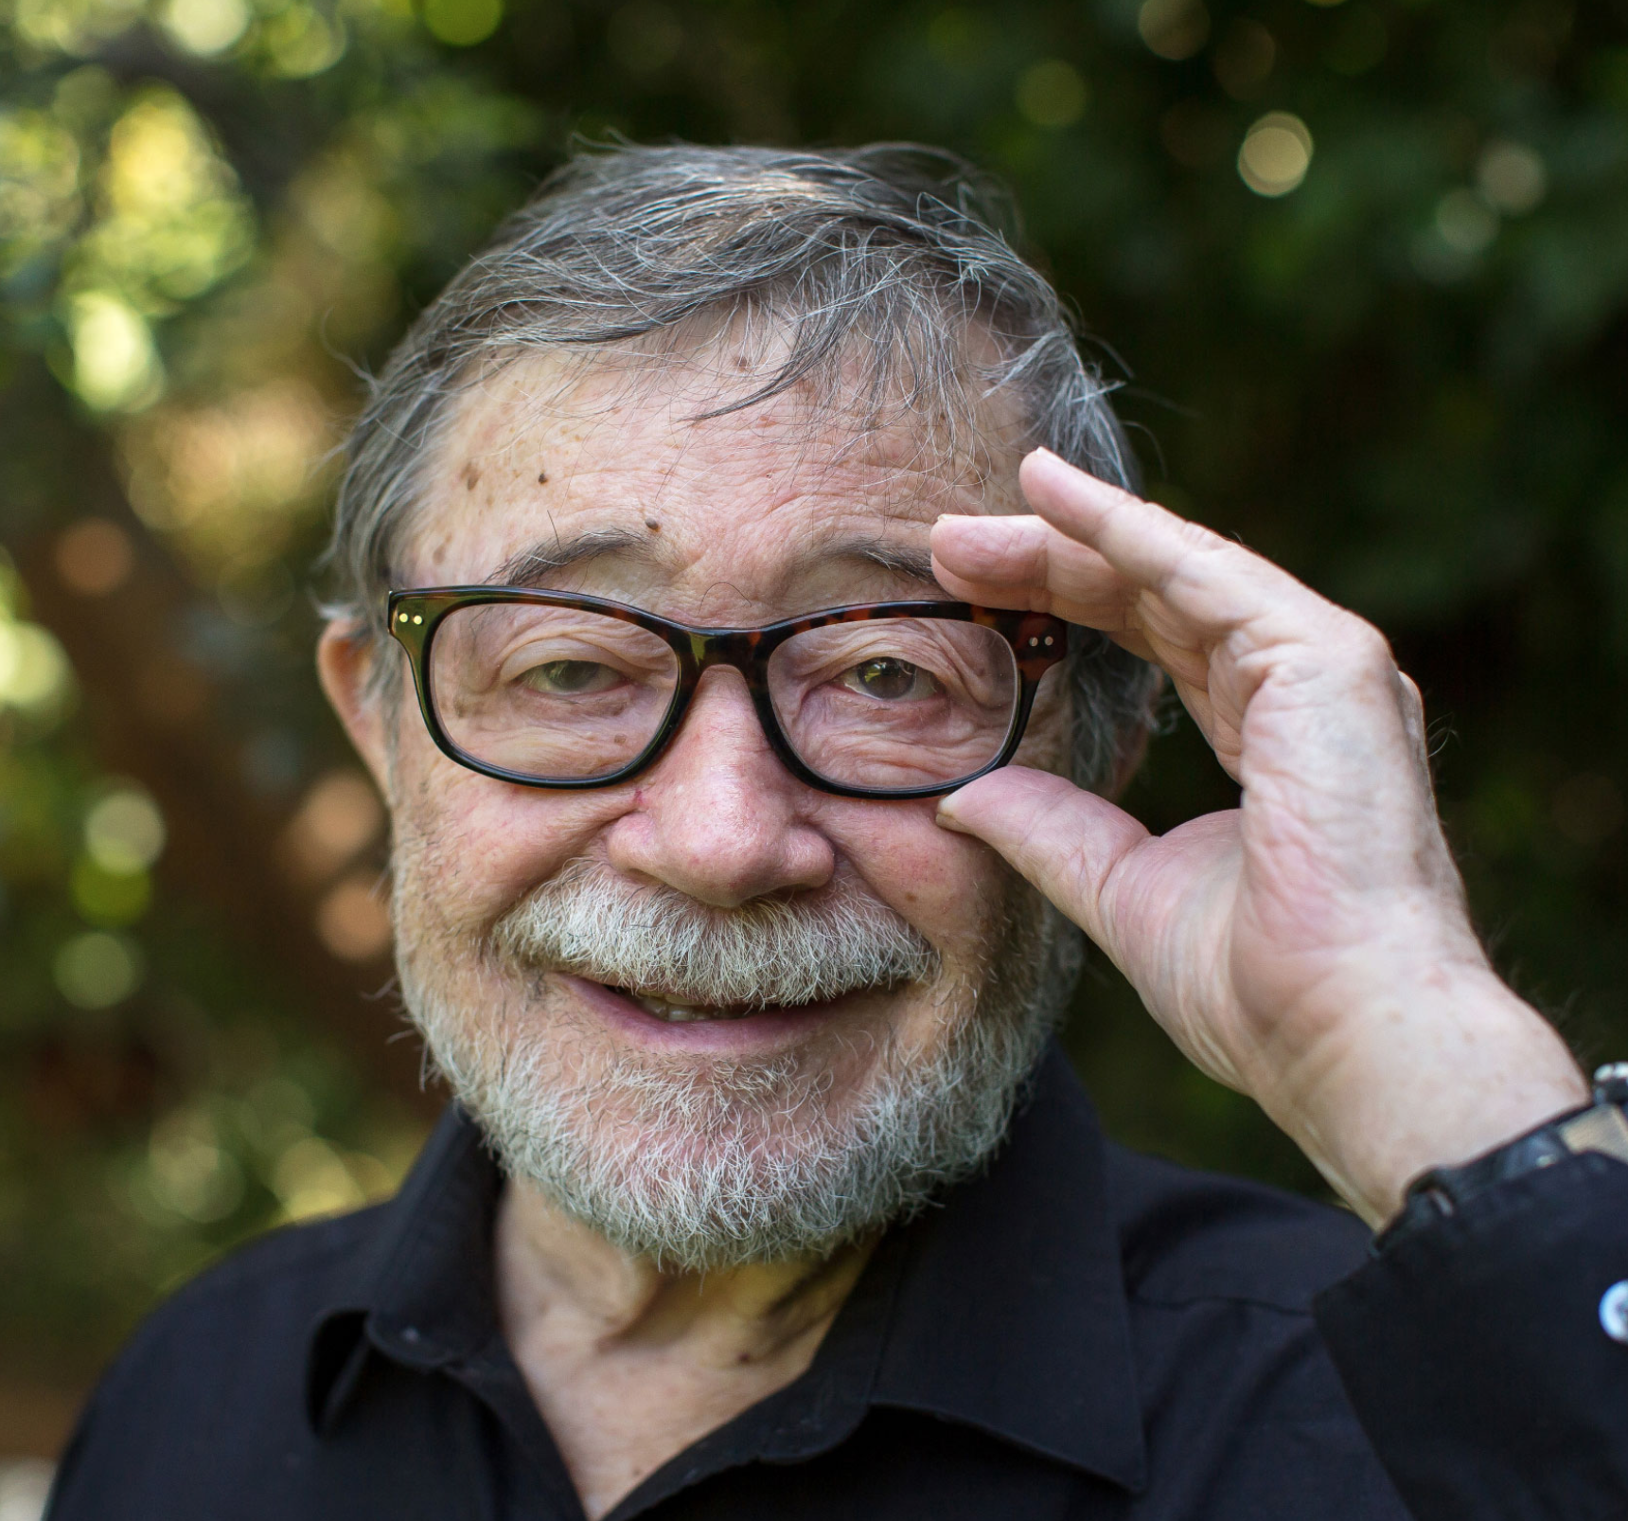
Parting thoughts
What do the haters say
Neural nets are “still just curve-fitting”
AI is still no closer to understanding cause & effect, agency, free will
(They’re probably right…)
How do I get started?
Hobbyist tinkering is the best way to learn: Sports analytics, market data, Kaggle competitions, your own data, …
Build understanding of theory as you tinker
Some good books: Start with: Intro to Statistical Learning, by Hastie/Tibshirani (it’s $free$, uses R) Advance to: Elements of Statistical Learning, by Hastie/Tibshirani Pattern Recognition and Machine Learning, by Bishop (also $free$ as of November 2018!) Machine Learning: a Probabilistic Perspective, by Murphy
Judea Pearl
Inventor of Bayesian networks
Turing Prize winner (2011)
Hater

Slide 30
Thanks!
Questions?

